Slide 1
ECE 3436 Microprocessor Systems Notes 5b: Test and Compare Operations
Ph.D. Jianfeng Zheng
Dept. ECE, Univ. of Houston
Email: jzheng4@central.uh.edu
Feb 19, 2026
Adapted from notes by Dr. Diana De La Rosa-Pohl

Slide 2
Today’s agenda in ECE 3436
Perform Test operations on register data
Perform Compare operations on register data
Flexible operand2

Slide 3
Test Operations
TEQ
Test equivalent
Test if 2 values are equal
Z=1 if equal
Uses bitwise EORS
Update N and Z condition flags
Does NOT store the result
MOV R0, #5
TEQ R0, #5 ; 0x0000
TEQ R0, #5 ; 0x0006
TST
Test
Test bits in Rn where mask is 1
Rd bits are 1 when both Rn bit and mask bit are 1, all others = 0
Uses bitwise ANDS
Update N and Z condition flags
Does NOT store the result
MOV R0, #5
TST R0, #5 ; 0x0005
TST R0, #3 ; 0x0001

Slide 4
TEQ
TEQ R2, R3
Register | Value
R0 | 2_0000…0101 1100
R1 | 2_0000…1101 1001
R2 | 2_0000…0111 0111
R3 | 2_0000…1111 0000
R4
R5
R6
R7
(EORS instructions w/o saving result)
(N & Z flags affected)
0111 0111
1111 0000

Slide 5
TST
TST R2, R3
Register | Value
R0 | 2_0000…0101 1100
R1 | 2_0000…1101 1001
R2 | 2_0000…0111 0111
R3 | 2_0000…1111 0000
R4
R5
R6
R7
(ANDS instructions w/o saving result)
(N & Z flags affected)
0111 0111
1111 0000

Slide 6
Compare operations
CMP
Compare
Compare 2 values for equivalence
Z=1 if equal
SUBS operand2 from operand1
Update N, Z, C & V condition flags
Does NOT store the result
MOV R0, #1
MOV R1, #-1
CMP R0, #1 ; 0x0000
CMP R0, R1 ; 0x0002
CMN
Compare Negative
Compare 2 values for equivalence but opposite signs
ADDS operand 2 and operand 1
Z=1 if equal but opposite signs
Update N, Z, C & V condition flags
Does NOT store the result
MOV R0, #1
MOV R1, #-1
CMN R0, #1 ; 0x0002
CMN R0, R1 ; 0x0000

Slide 7
Compare operations
CMP R0, R1
Register | Value
R0 | 2_0000…0101 1100
R1 | 2_0000…1101 1001
R2 | 2_0000…0111 0111
R3 | 2_0000…1111 0000
R4
R5
R6
R7
(SUBS instruction w/o saving result)
(N, Z, C & V flags affected)
0000 0001
1111 1111
N=Z=C=V=0

Slide 8
Compare operations
CMN R0, R1
Register | Value
R0 | 2_0000…0101 1100
R1 | 2_0000…1101 1001
R2 | 2_0000…0111 0111
R3 | 2_0000…1111 0000
R4
R5
R6
R7
(ADDS instruction w/o saving result)
(N, Z, C & V flags affected)
0000 0001
1111 1111
N=0, Z= 1, C= 1, V=0

Slide 9
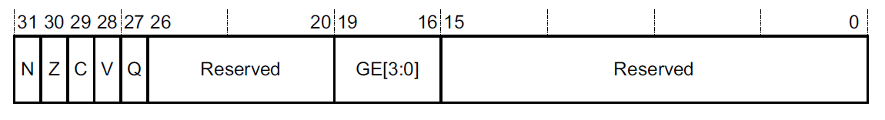
Condition Flags
FLAGS
N, bit[31] Negative condition code flag. If the result is regarded as a two’s complement signed integer, then N==1 if the result is negative and N==0 if it is positive or zero.
Z, bit[30] Zero condition code flag. Set to 1 if the result of the instruction is zero, and to 0 otherwise.
C, bit[29] Carry condition code flag. Set to 1 if the instruction results in a carry condition.
V, bit[28] Overflow condition code flag. Set to 1 if the instruction results in an overflow condition.

Slide 10
Condition Flags
Bit | Name | Meaning if set (1)
N | negative | Result is negative
Z | zero | Result is zero
V | overflow | Signed overflow
C | carry | Unsigned addition overflow
C flag
Set (1) after an unsigned addition if the answer is wrong
Clear (0) after an unsigned subtraction if the answer is wrong
V flag
Set (1) after a signed addition or subtraction if the answer is wrong

Slide 11
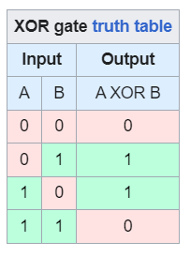

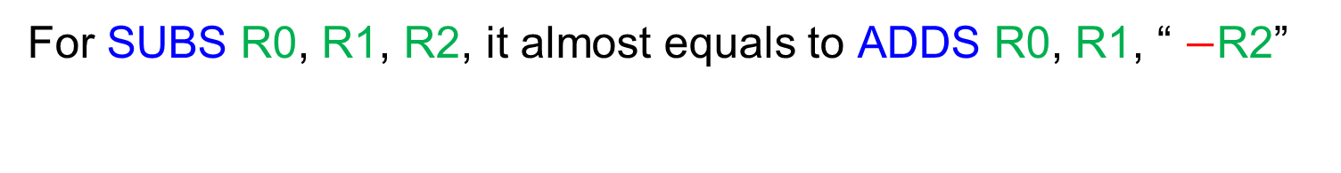
C flag and V flag
Co, carry out
Ci, carry in
Define:
Co: Carry out at MSB
Ci: Carry in at MSB
$$XOR\left(A,B\right)=\left(A∙\overline{B}\right)+\left(\overline{A}∙B\right)$$
0 1 0 0 0 0 0 1
+ 1 1 0 1 0 0 1 1
1 0 0 0 1 0 1 0 0
Then:
C = Co
V = XOR (Ci, Co)
In the shown example, Ci = 1, Co =1, we get C = 1 and V = 0.
For SUBS R0, R1, R2, it almost equals to ADDS R0, R1, “ $−$R2”

Slide 12
Shift Operations w/carry bit
31 | 30 | 29 | 28 | 27 | 26 |  |  |  | 1 | 0
C
Logical Shift Right
LSR
1≤n≤32
0
31 | 30 | 29 | 28 | 27 | 26 |  |  |  | 1 | 0
C
Arithmetic Shift Right
ASR
1≤n≤32
31 | 30 | 29 | 28 | 27 | 26 |  |  |  | 1 | 0
C
Logical Shift Left
LSL
0≤n≤31
0
Use the ASR instruction when manipulating signed numbers, and use the LSR instruction when shifting unsigned numbers.

Slide 13
Rotate Operations
31 | 30 | 29 | 28 | 27 | 26 |  |  |  | 1 | 0
C
Rotate Shift Right
ROR
1≤n≤32
31 | 30 | 29 | 28 | 27 | 26 |  |  |  | 1 | 0
C
Rotate Right Extended
RRX
0≤n≤31

Slide 14
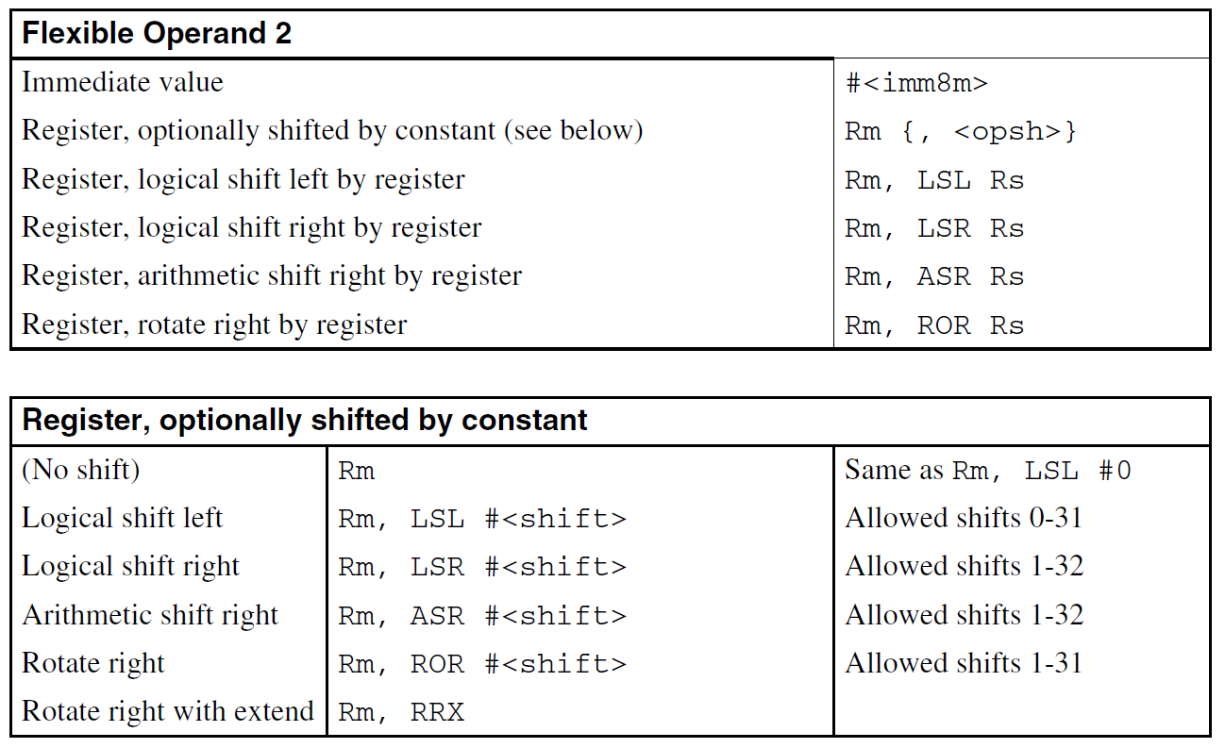
Flexible Operand2, Shift and Rotate

Slide 15
Logical Operations Recap
A Rn | B Operand2 (Mask) | A&B AND | A|B ORR | A^B EOR | A&(~B) BIC | A|(~B) ORN
0 | 0 | 0 | 0 | 0 | 0 | 1
0 | 1 | 0 | 1 | 1 | 0 | 0
1 | 0 | 0 | 1 | 1 | 1 | 1
1 | 1 | 1 | 1 | 0 | 0 | 1
Logical operations
AND{S} {Rd,} Rn, <op2> ;Rd=Rn&op2, Clear bits where B=0
ORR{S} {Rd,} Rn, <op2> ;Rd=Rn|~op2, Set bits where B=1
EOR{S} {Rd,} Rn, <op2> ;Rd=Rn^op2, Toggle bits where B=1
BIC{S} {Rd,} Rn, <op2> ;Rd=Rn&(~op2), Clear bits where B=1
ORN{S} {Rd,} Rn, <op2> ;Rd=Rn|(~op2), Set bits where B=0

Slide 16
PRACTICE
Logical operations without setting flags
AND R4, R1, #0xFF
AND R5, R2, R3
ORR R6, R3, R0
EOR R7, R3, R0
BIC R8, R2, R3
ORN R9, R3, R1
Register | Value
R0 | 0000…0101 1100
R1 | 0000…1101 1001
R2 | 0000…0111 0111
R3 | 0000…1111 0000
R4
R5
R6
R7
R8
R9

